Slide 1

Yum in My Tum!
Calorie, Fat and Weight Tracking Application
To provide a visualization of the correlation between calorie and fat consumption and weight trends

Slide 2
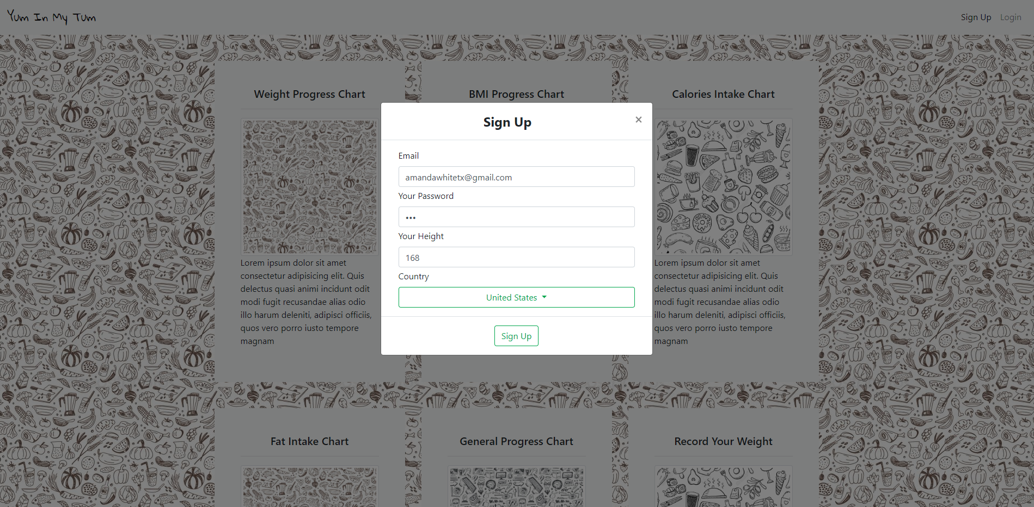
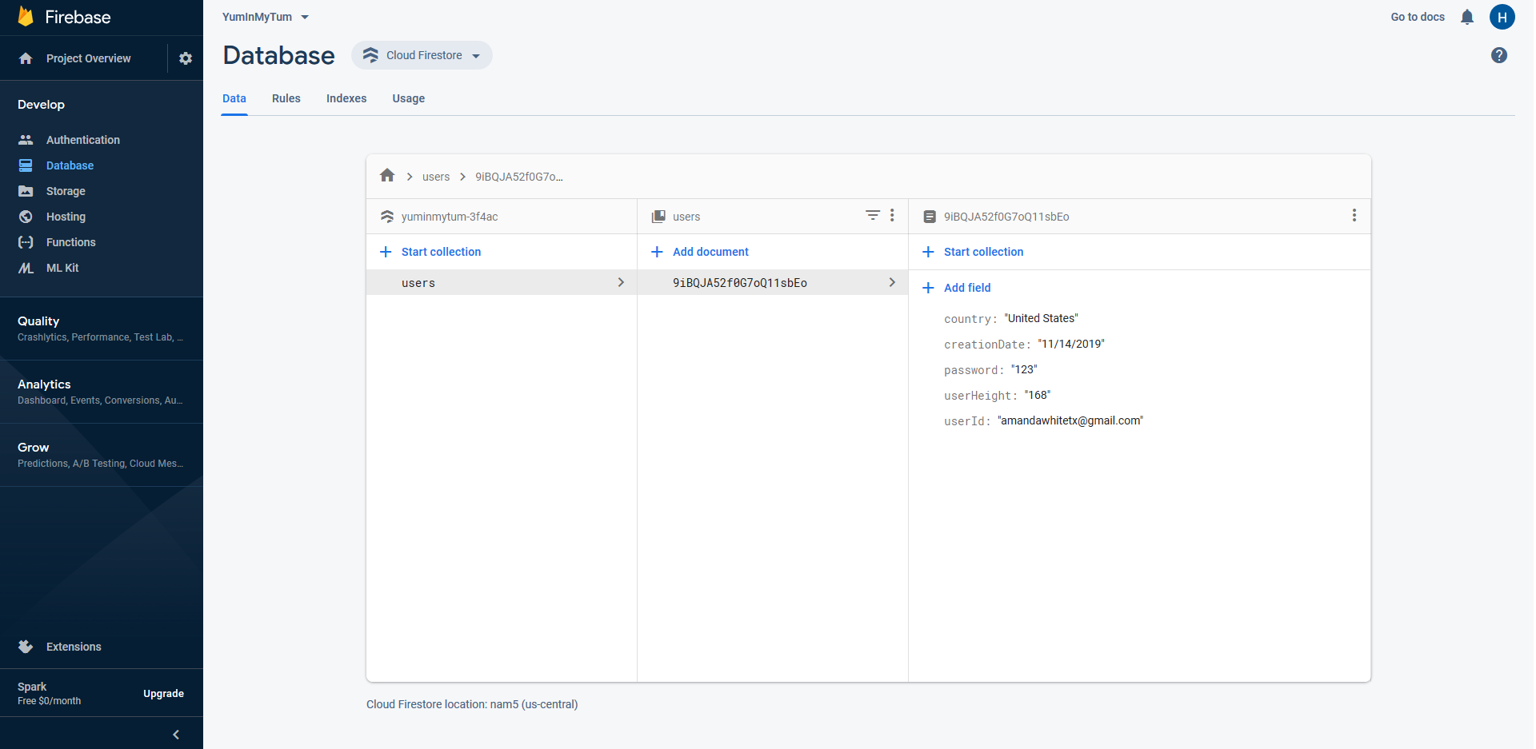
User Account Sign Up

Slide 3
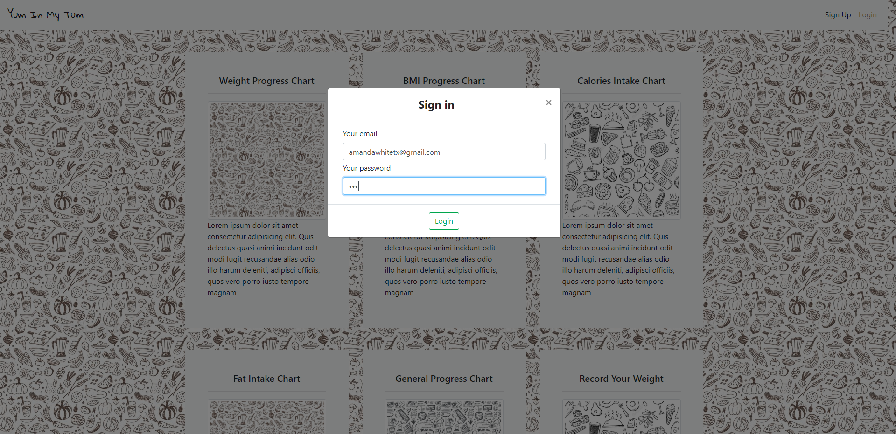
User Sign In

Slide 4
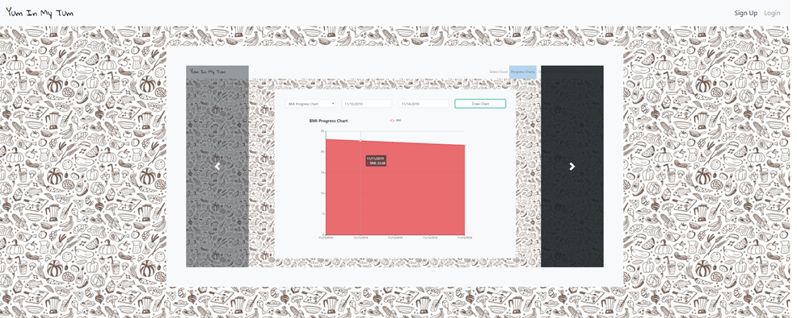
Home Page

Slide 5
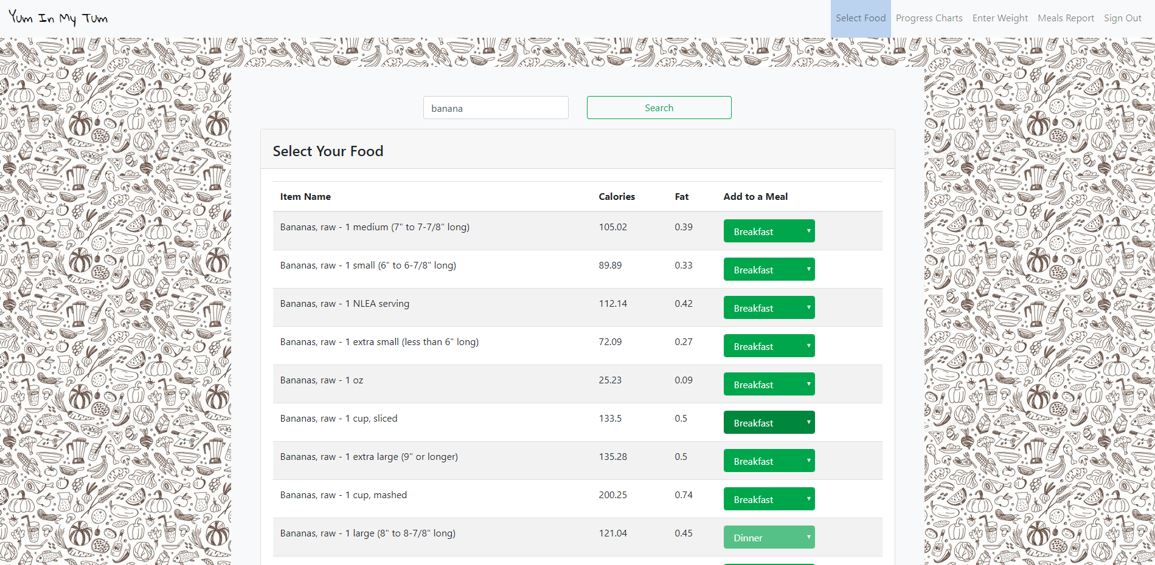
Meal Selection
User will select meals which uses the Nutritionix API food search

Slide 6
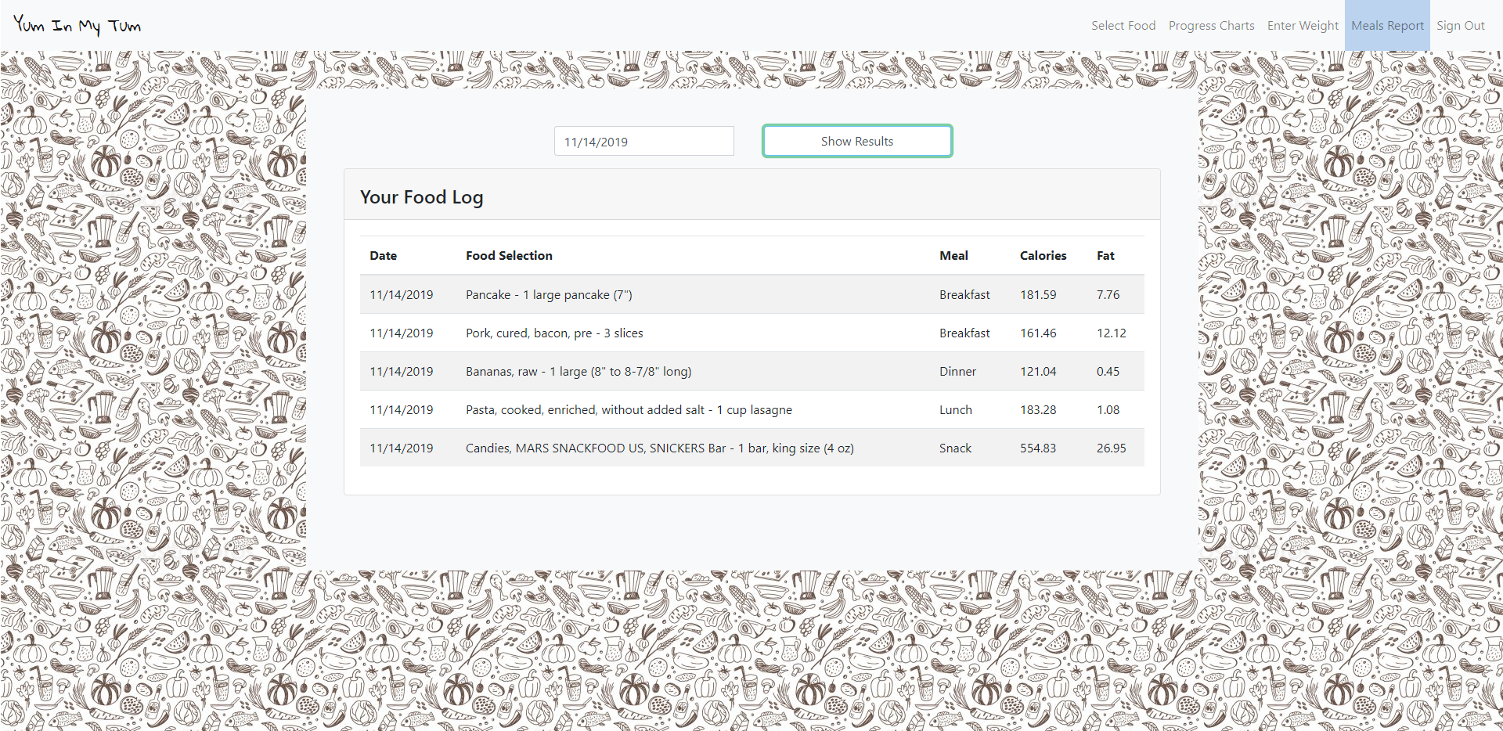
Daily Meal Log
Shows the food entries for the selected date

Slide 7
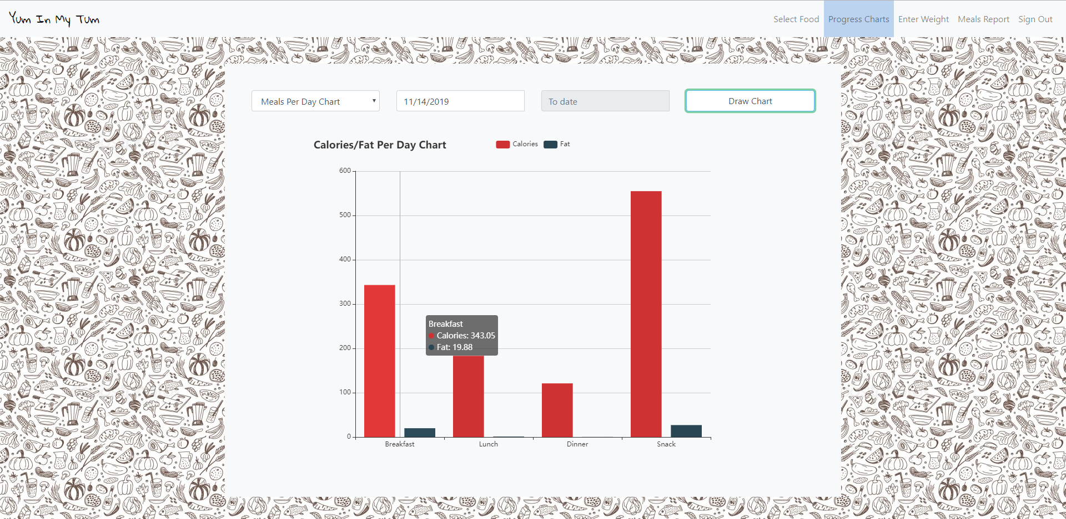
Calories and Fat chart
Shows the total Fat and Calories by Day over a time

Slide 8
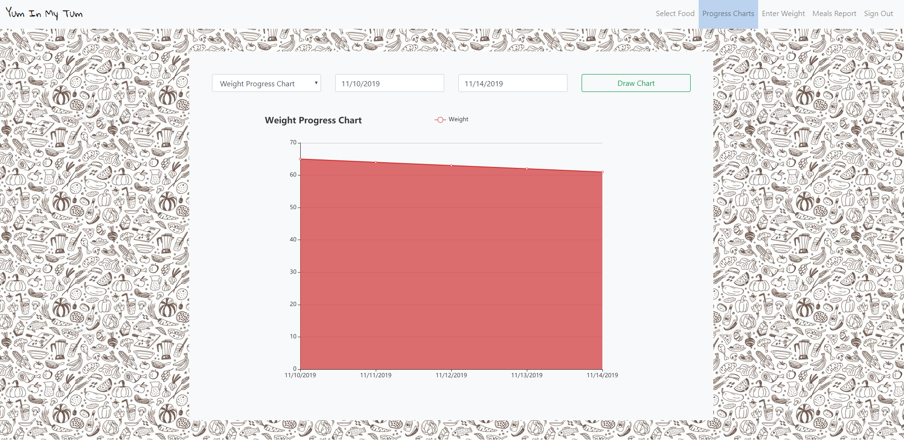
Weight Progress Chart
Shows Weight Loss Progress over a period of time entered by the user

Slide 9
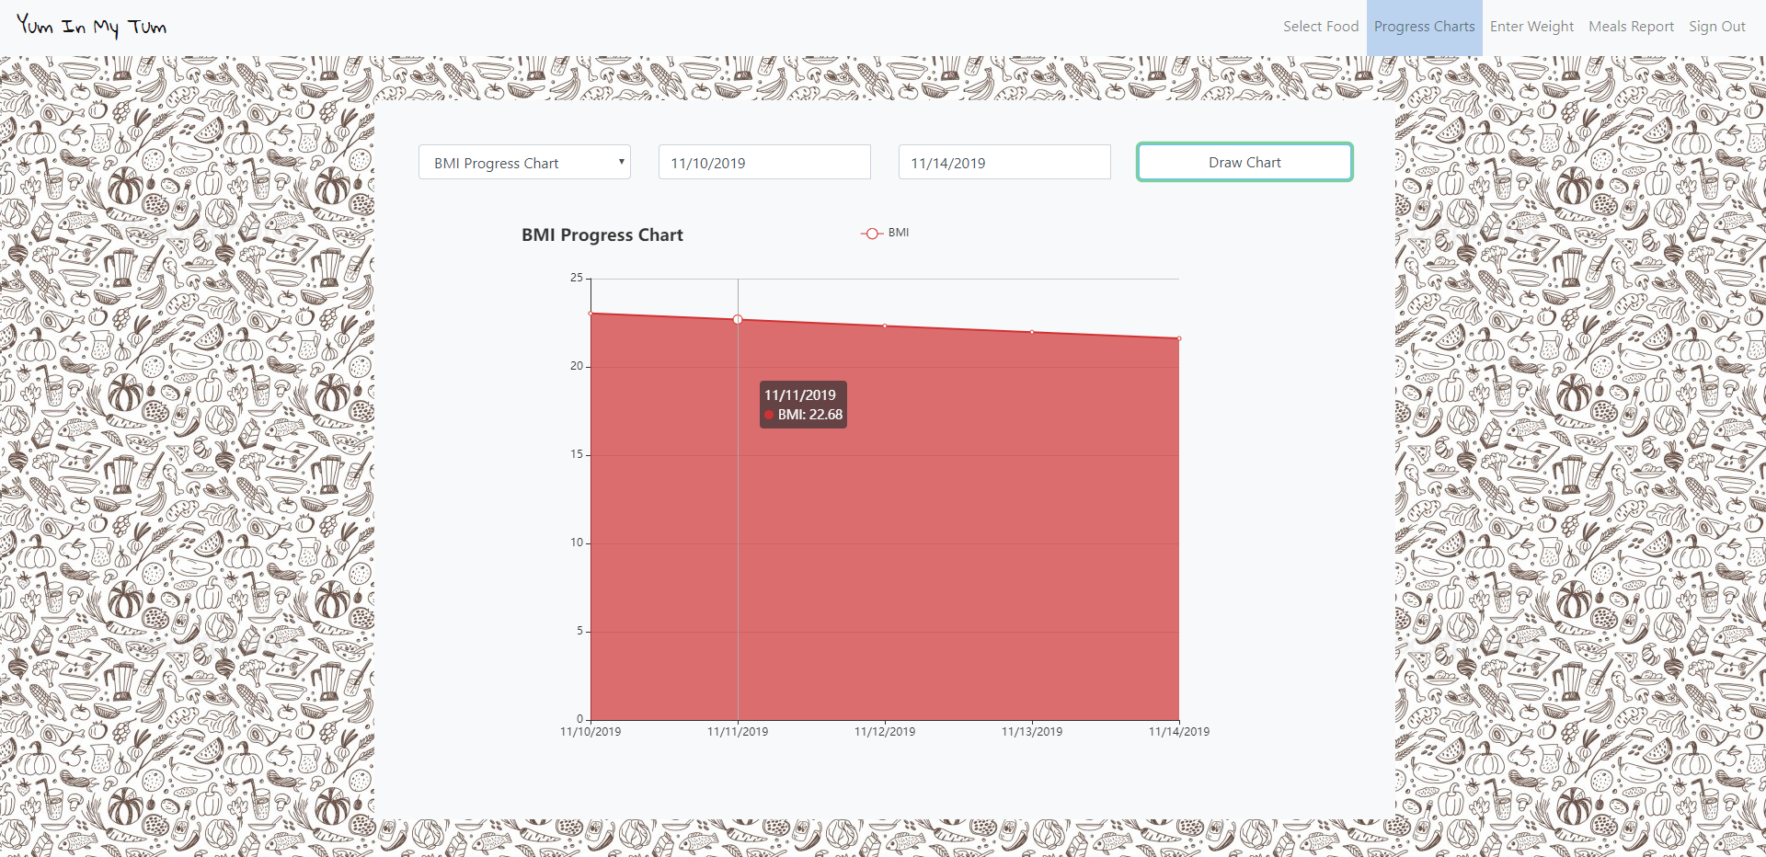
Weight Progress Chart
Shows Weight Loss Progress over a period of time entered by the user

Slide 10
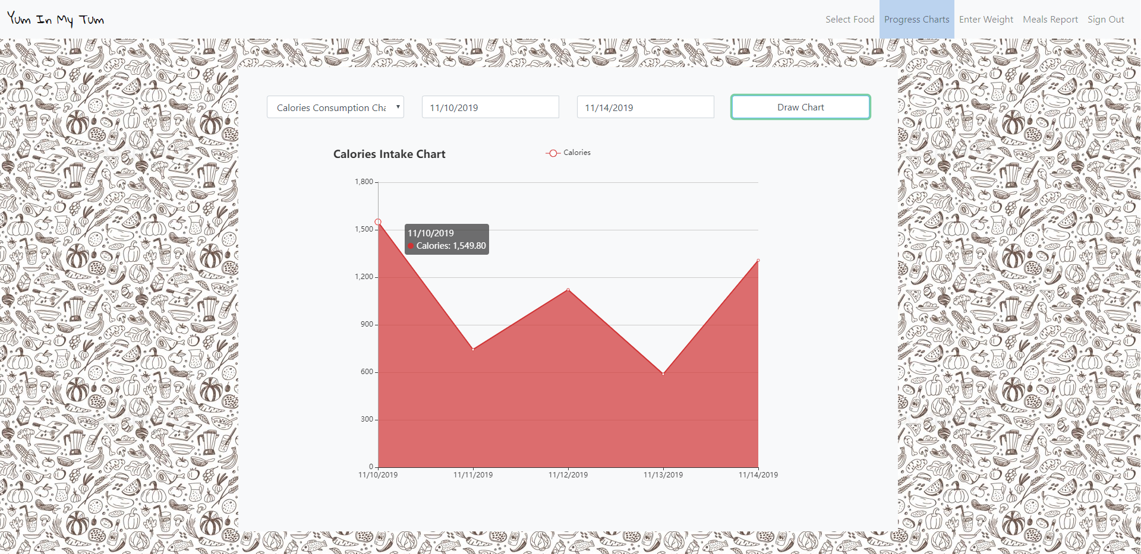
Calorie intacke Chart
Shows Weight Loss Progress over a period of time entered by the user

Slide 11
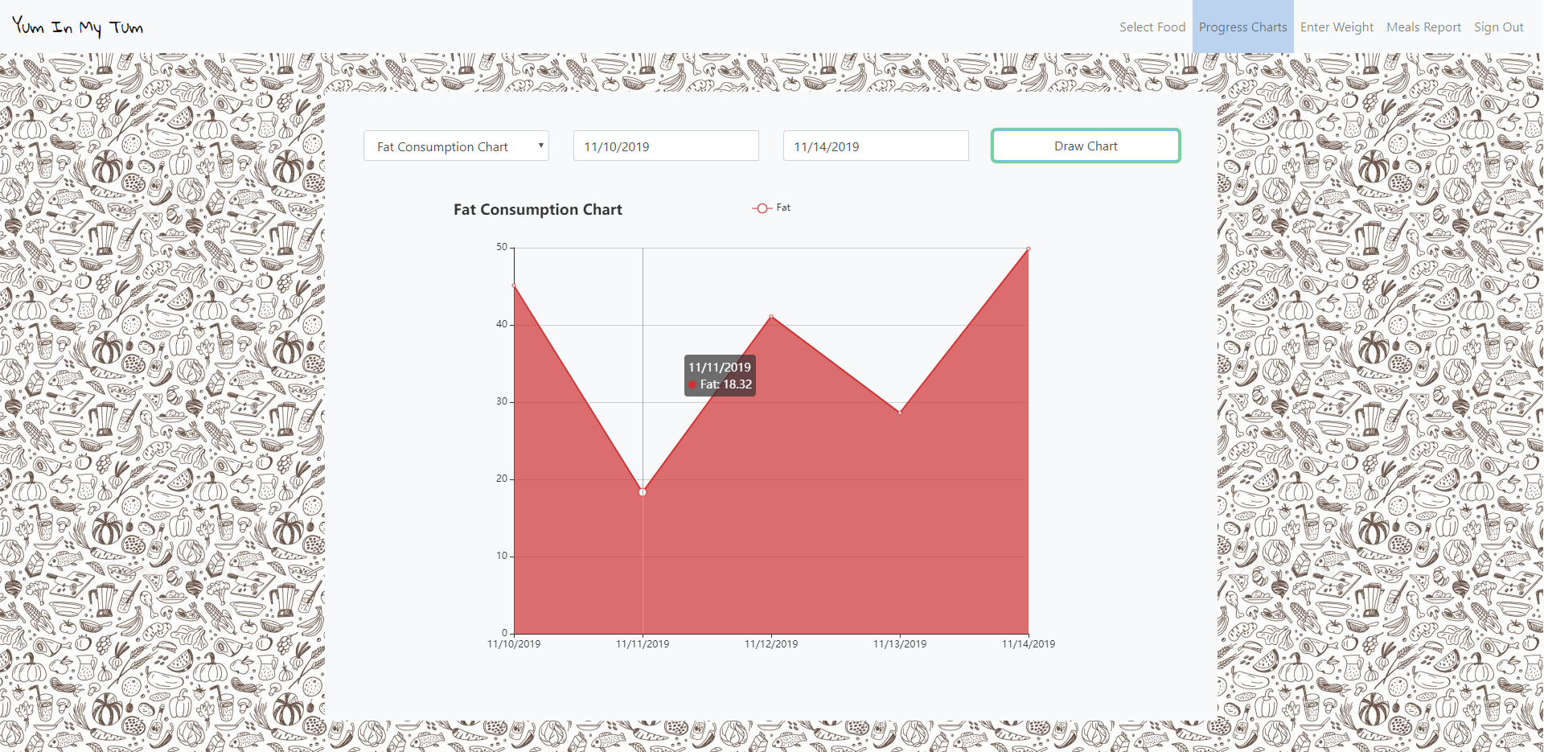
Fat consumption Chart
Shows Weight Loss Progress over a period of time entered by the user

Slide 12
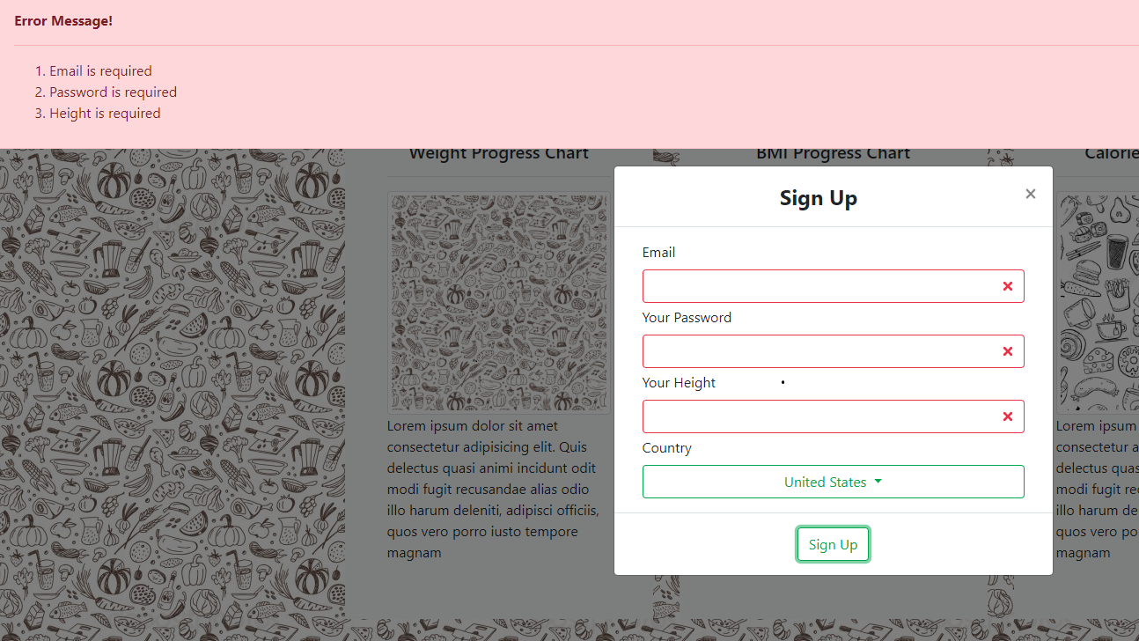
Input Validation
User Country Selection –Validation using Countries API

Slide 13

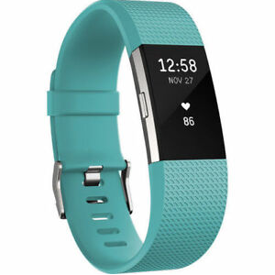

Future Development
Create/Find an API to utilize a scale that would automatically log the weight/date entries in the application
Use UPC API to scan food items and enter nutritional information
Utilize wearable fitness trackers to log number of calories burned each day (fitbit, apple watch)

Slide 14
Team Members
Ariel Morales
Amanda White
Hamza Hamdan

